Slide 1



Session 2.1:
Embeddings & Vector Math
The Core Mechanics of Semantic Intelligence: Translating human abstract thought into deterministic high-dimensional coordinate systems.

Slide 2


The Evolution of Semantic Search
Legacy Lexical Matching
Modern Semantic Geometry
Computers historically viewed language as strict binary character overlaps (ASCII/UTF-8). In a traditional SQL database, a search for "Dog" ignores "Puppy".
Embeddings solve the sensory problem by mapping text to numerical vectors. In this space, proximity in distance represents relatedness in human concept.
Lexical matching is blind to meaning. It requires 100% character precision, failing instantly when synonymous intent is presented.
Machines can now "understand" that "Puppy is joyful" and "Dog is happy" are semantically identical by measuring their coordinate distance.

Slide 3






Why Legacy Search Fails at Scale
Bag of Words
Logical Collapse
TF-IDF Limits
Treats documents as simple collections of word counts. It strips away grammar, sentence structure, and crucial word order.
"The man bit the dog" vs. "The dog bit the man" are identical in a BoW model. Contextual meaning is completely destroyed.
While TF-IDF helps filter noise, it remains a purely statistical keyword tool with no understanding of conceptual similarity.

Slide 4

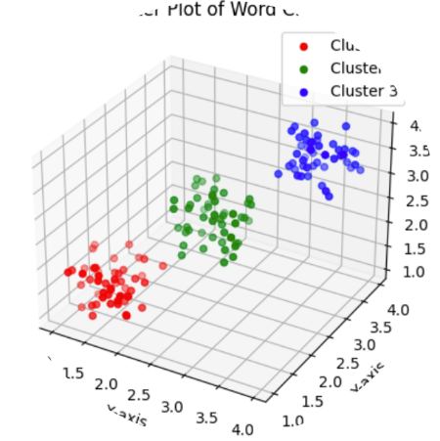
The Geometry of Meaning
The 2D Coordinate Analogy
Imagine mapping words based on specific human traits as axes:
X-Axis: Animal-like (0.0 to 1.0)
Y-Axis: Domesticated (0.0 to 1.0)
Under these rules, "Dog" [0.9, 0.9] and "Wolf" [0.9, 0.1] are neighbors. "Helicopter" [0.0, 0.0] is miles away. Meaning is now distance.

Slide 5

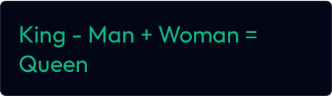
Algebra on Language: Word2Vec
The 2013 Breakthrough
Researchers proved that mapping words to vectors enables true linguistic algebra. By adding/subtracting vectors, we navigate concepts.
Queen
The Geometric Intersection
The neural network discovered royalty and gender independently by analyzing the statistical proximity of words in massive datasets.

Slide 6
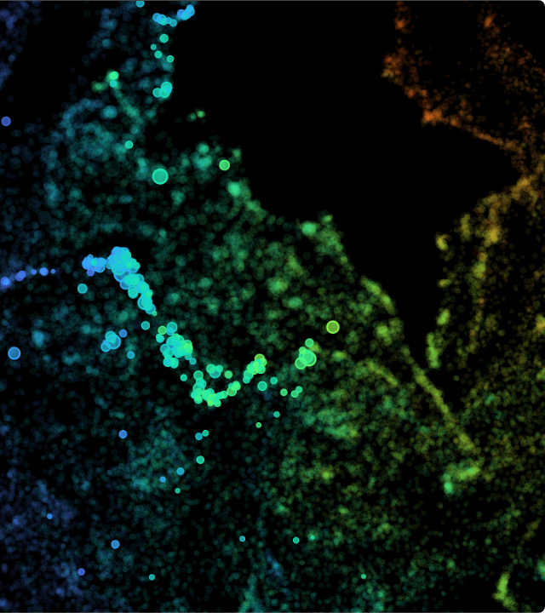

High-Dimensional Space
Modern models navigate hundreds or thousands of dimensions in a High-Dimensional Hypersphere.
The 768D Standard
Google text-embedding-004: 768 dims
OpenAI text-embedding-3: 3,072 dims
These dimensions capture nuanced concepts humans cannot name—capturing formality, sarcasm, and domain-specific logic like audit compliance.

Slide 7



Search Metric: Euclidean Distance
Straight-Line Distance ($L^2$)
The Magnitude Problem
Measures literal proximity between vector tips using the Pythagorean theorem. Ideal for physics, but often fails in text processing.
Euclidean math is sensitive to vector length. A 500-word audit and a 5-word summary point in the same direction but are physically distant due to word count magnitude.
Magnitude inflation makes Euclidean distance unreliable for comparing documents of varying lengths.

Slide 8



The Foundation: Dot Product
Inner Product Logic
Shared Directionality
Calculated by multiplying matching dimensions and summing them. It is the fundamental operation for neural attention.
If vectors point in the same direction, the score is a large positive number. Opposite directions yield negative numbers.
Like Euclidean, it is sensitive to magnitude. Longer documents produce massive scores that drown out high-quality short semantic matches.

Slide 9


The Gold Standard: Cosine Similarity
Normalization of Meaning
Similarity Benchmarks
By measuring the Angle ($\theta$) rather than the distance between points, we strip away the document's length and isolate its intent.
1.0 (0°): Perfectly identical intent.
0.0 (90°): Orthogonal/Unrelated.
-1.0 (180°): Exact opposite meaning.
Cosine Similarity is the most robust metric for enterprise RAG and cross-document comparison.

Slide 10
Metric Performance Benchmarks
Scenario | Cosine Similarity | Euclidean Distance | MLOps Impact
Synonym Matching (Dog vs. Canine) | High Similarity (~0.9) | Low Distance | Success: Meaning is captured
Length Variance (10 vs. 500 words) | Accurate Angle | High Distance (Fail) | Euclidean distorted by magnitude
Unrelated Noise (AI vs. Cooking) | Low Score (~0.1) | High Distance | Success: Noise is filtered
Negation (Yes vs. NO) | High Error (~0.9) | Low Distance | Both Fail: Negation Neighborhoods
Caution: Vector search finds "Neighborhoods," not "Reasoning." Handling negation requires an LLM to read the retrieved chunks in later stages.

Slide 11



Infrastructure & Financial Realities
RAM Footprint
Cost of Dimensions
Optimization Goal
One 768-dim vector (float32) takes ~3KB. At scale, 100M chunks require 300GB of high-speed active RAM.
3,072-dim models cost 4x more to host. However, they often yield only a ~1% increase in semantic retrieval accuracy.
Senior engineers prioritize Efficiency > Excess. Google's 768-dim model is the industry "Sweet Spot" for ROI.

Slide 12

Advanced Architectures
Bi-Encoders (The Searcher)
Sub-millisecond latency.
Perfect for searching millions of document chunks instantly.
Cross-Encoders (The Re-ranker)
Human-level precision.
High latency. Used only to re-rank the Top 10 results from the Bi-encoder.

Slide 13

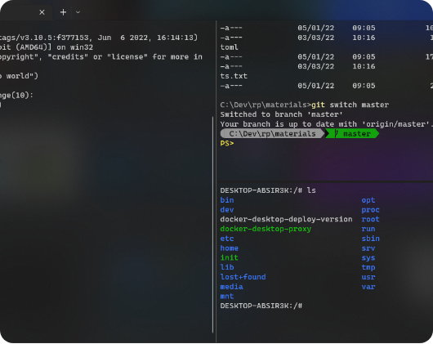
Hands-On: The Embedding Lab
Engineering Benchmarks
We use Python and NumPy to prove the superiority of Cosine Similarity for the 'Extract Once' pipeline.
Model: text-embedding-004 (Google).
Challenge: Comparing synonyms vs. length discrepancy.
Proof: Cosine remains >0.99 for artificial length inflation.
"Mapping corporate data to 768D coordinates is the bridge between unstructured noise and surgical automation."

Slide 14




Summary & Next Steps
We have successfully discarded lexical keyword matching and mastered the geometry of language. We can now map millions of corporate data points into high-dimensional space for sub-millisecond retrieval.

